Slide 1
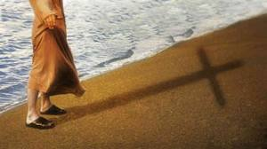
Welcome to St Michael’s
13th Sunday in Ordinary Time Year C
Please ensure all mobile phones are switched off.
Please be respectfully quiet as we prepare for our Celebration.
‘Follow me,’
Notes:
Saturday 5.30PM First Sunday of Advent
7am - 7th Sunday in Ord Time Year B

Slide 2
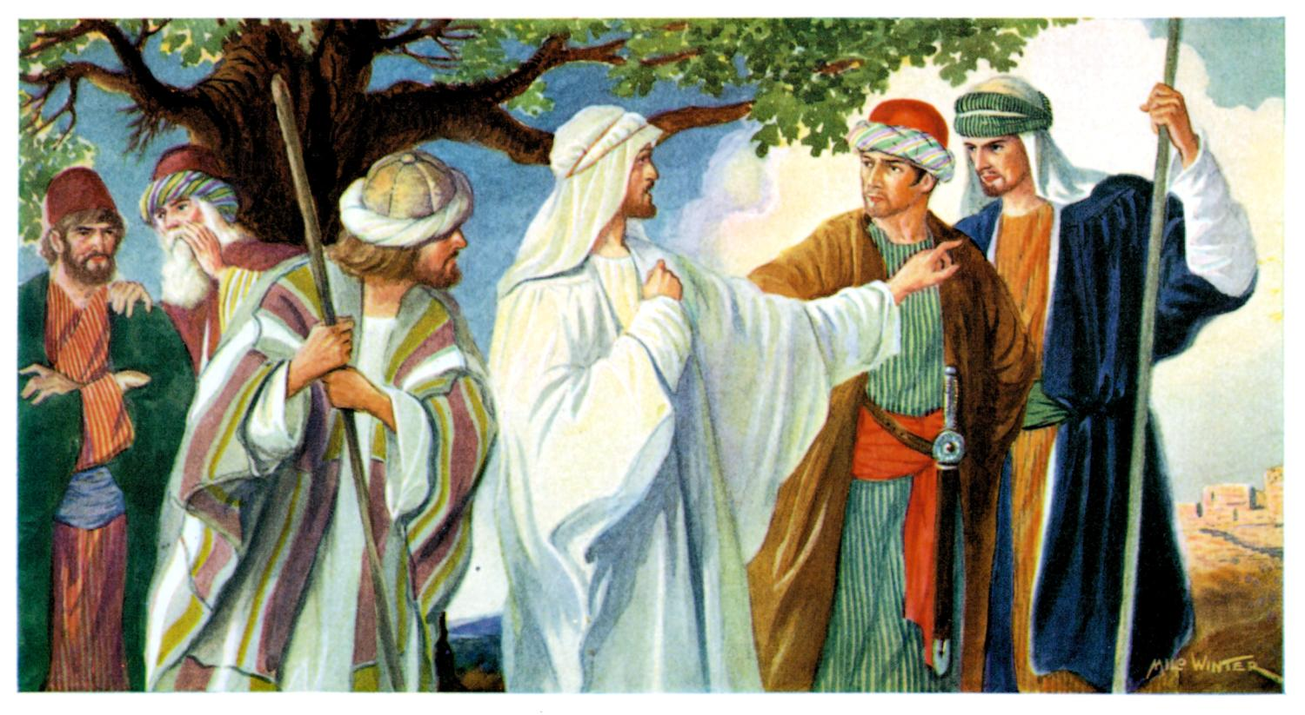
Jesus resolutely took the road for Jerusalem…along the way they
met a man …

Slide 3
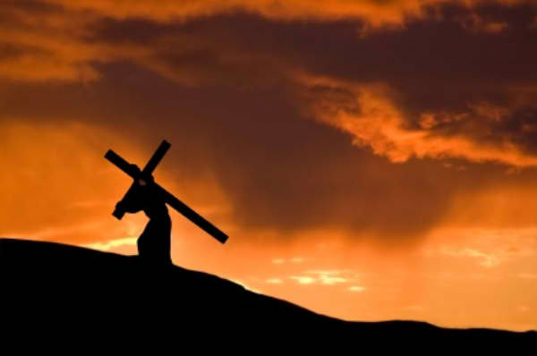
“He said, I will follow you wherever you go.”

Slide 4
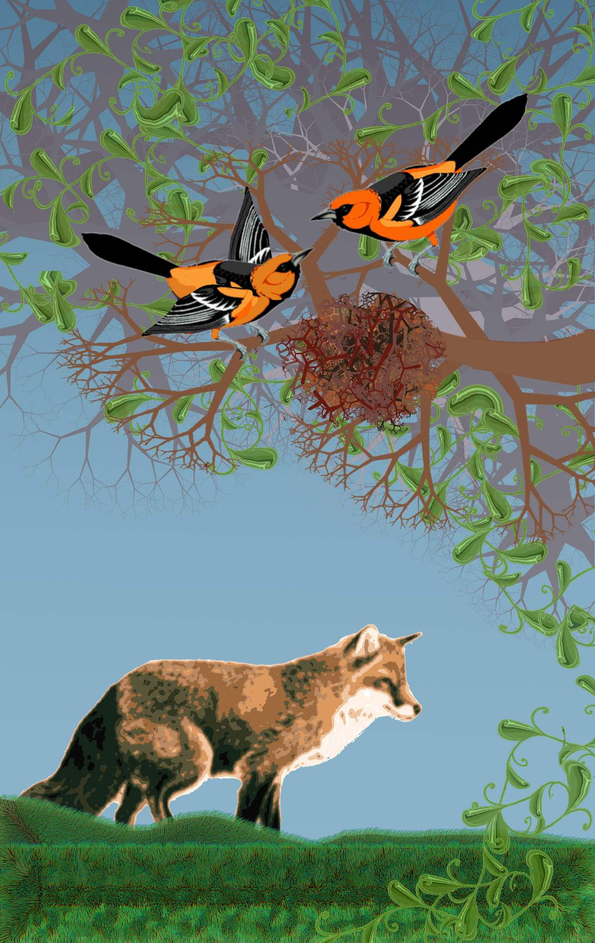
Jesus answered, ‘Foxes have holes and the birds of air have nests …

Slide 5
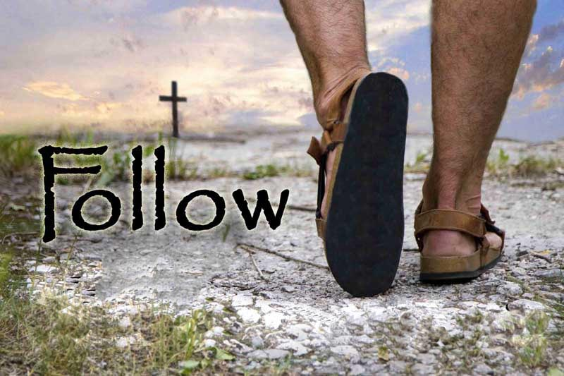
What does it mean for me to follow Jesus?

Slide 6
Please Stand

Slide 7
Gather as One
Gather as one, Gather as one.
Gather all the people of God!
All of our days singing God's praise
Gather all the people as one

Slide 8
We will sing a new song unto the Lord,
Of truth and beauty surrounding our God;
Of holiness and glory
Sing out to the Lord, all the earth!

Slide 9
Gather as one, Gather as one.
Gather all the people of God!
All of our days singing God's praise
Gather all the people as one

Slide 10
Gather all the nations unto the Lord.
Bring us together, our Lord and our God
And we will come rejoicing,
Proclaiming the Lord's holy name!

Slide 12
Kyrie eleison
Kyrie eleison (2)
Christe eleison (2)
Kyrie eleison (2)

Slide 14
Gloria
Glory to God in the highest,
and on earth peace to people of good will.
We praise you, we bless you,
we adore you, we glorify you,

Slide 15
We give you thanks for your great glory,
Lord, God heavenly king,
O God, almighty father

Slide 16
Glory to God in the highest,
and on earth peace to people of good will.

Slide 17
Lord Jesus Christ, Only Begotten Son,
Lord God, Lamb of God, Son of the Father,
you take away the sins of the world,
have mercy on us;

Slide 18
you take away the sins of the world, receive our prayer;
you are seated at the right hand of the Father,
have mercy on us.

Slide 19
Glory to God in the highest,
and on earth peace to people of good will.

Slide 20
For you alone are the Holy One,
you alone are the Lord,
you alone are the Most High,
Jesus Christ,
with the Holy Spirit,
in the glory of God the Father.

Slide 21
Glory to God in the highest,
and on earth peace to people of good will.
Amen.

Slide 23
Responsorial Psalm
You are my inheritance, O Lord

Slide 25
Alleluia
Alleluia, alleluia,
alleluia, alleluia

Slide 27
Apostles Creed
I believe in God,
the Father almighty,
Creator of heaven and earth,
and in Jesus Christ, his only Son, our Lord,
(At the words that follow, up to and including the Virgin Mary, all bow.)

Slide 28
who was conceived by the Holy Spirit,
born of the Virgin Mary,
suffered under Pontius Pilate,
was crucified, died and was buried;
he descended into hell;

Slide 29
on the third day he rose again from the dead;
he ascended into heaven,
and is seated at the right hand of God the Father almighty;
from there he will come to judge the living and the dead.

Slide 30
I believe in the Holy Spirit,
the holy catholic Church,
the communion of saints, the forgiveness of sins,
the resurrection of the body, and life everlasting.
Amen.

Slide 32
First Collection
This collection goes to the Bishop
for the support of the Diocese.
Thank you for your contribution

Slide 34
Blessed Be our God
Take this bread,
Take this bread,
Gift and work of human hands.

Slide 35
Take this wine,
Take this wine,
From this branch of your vine.

Slide 36
Take our lives,
Take our lives
As an offering to you,
God of mercy,
Singing “Blessed be our God!”

Slide 37
Take this bread,
Take this bread,
Gift and work of human hands.

Slide 38
Take this wine,
Take this wine,
From this branch of your vine.

Slide 39
Take our lives,
Take our lives
As an offering to you,
God of mercy,
Singing “Blessed be our God!”

Slide 40
Take this bread,
Take this bread,
Gift and work of human hands.

Slide 41
Take this wine,
Take this wine,
From this branch of your vine.

Slide 42
Take our lives,
Take our lives
As an offering to you,
God of mercy,
Singing “Blessed be our God!”

Slide 44
All: May the Lord accept the sacrifice
at your hands for the praise and glory of his name, for our good and the good of all his holy Church.

Slide 46
Holy
Holy, Holy, Holy Lord God of hosts,
Heaven and earth are full of your glory. Hosanna in the highest
Blessed is he who comes
in the name of Lord,
Hosanna in the highest.

Slide 48
Memorial acclamation
Save us saviour of the world,
For by your cross and resurrection,
You have set us free

Slide 50
Peace
May the peace of the Lord be with you
With your friends and your family too
Let it be, let it grow
And everywhere you go
May the peace of the Lord follow you

Slide 51
Lamb of God
Lamb of God, lamb of God
You take away the sins of the world
Have mercy on us, lamb of God
Lamb of God, lamb of God
You take away the sins of the world
Have mercy on us, lamb of God

Slide 52
Lamb of God, lamb of God
You take away the sins of the world
Grant us, grant us peace

Slide 54
All: Lord, I am not worthy
that you should enter under my roof,
but only say the word
and my soul shall be healed.

Slide 56
This is my body
This is my body, broken for you
Bringing forgiveness, making you free
Take it and eat it, and when you do,
Do it in love for me

Slide 57
This is my blood, poured out for you
Bringing you wholeness, making you free
Take it and drink it, and when you do
Do it in love for me

Slide 58
Take and eat
Take and eat, take and eat,
This is my body given up for you.
Take and drink, take and drink,
This is my blood given up for you.

Slide 59
I am the Word that spoke
and light was made;
I am the seed that died to be reborn;

Slide 60
I am the bread that comes
from heaven above;
I am the vine that fills
your cup with joy.

Slide 61
Take and eat, take and eat
This is my body given up for you
Take and drink, take and drink
This is my blood, given up for you

Slide 62
I am the Lamb that takes away your sin;
I am the gate that
guards you night and day.

Slide 63
You are my flock;
you know the shepherd’s voice.
You are my own;
your ransom is my blood

Slide 64
Take and eat, take and eat
This is my body given up for you
Take and drink, take and drink
This is my blood, given up for you

Slide 65
I am the light that came into the world
I am the light
that darkness cannot hide;

Slide 66
I am the morning star that never sets;
Lift up your face,
in you my light will shine

Slide 67
Take and eat, take and eat
This is my body given up for you
Take and drink, take and drink
This is my blood, given up for you

Slide 68
Thy word
Thy Word is a lamp unto my feet
and a light unto my path
Thy Word is a lamp unto my feet
and a light unto my path

Slide 69
When I feel afraid
and think I've lost my way
Still You're there right beside me

Slide 70
And nothing will I fear
as long as You are near
Please be near me 'til the end

Slide 71
Thy Word is a lamp unto my feet
and a light unto my path
Thy Word is a lamp unto my feet
and a light unto my path

Slide 72
I will not forget
Your love for me, and yet
My heart forever is wandering

Slide 74
Second Collection
What you contribute now
is for the support of our
parish and its mission.
Thank you for your generosity

Slide 75
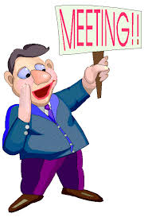
Parish Pastoral Council (PPC)
Monday, 1 July
at 7.30pm
in the Meeting Room
In the Parish Office
All Welcome!

Slide 76
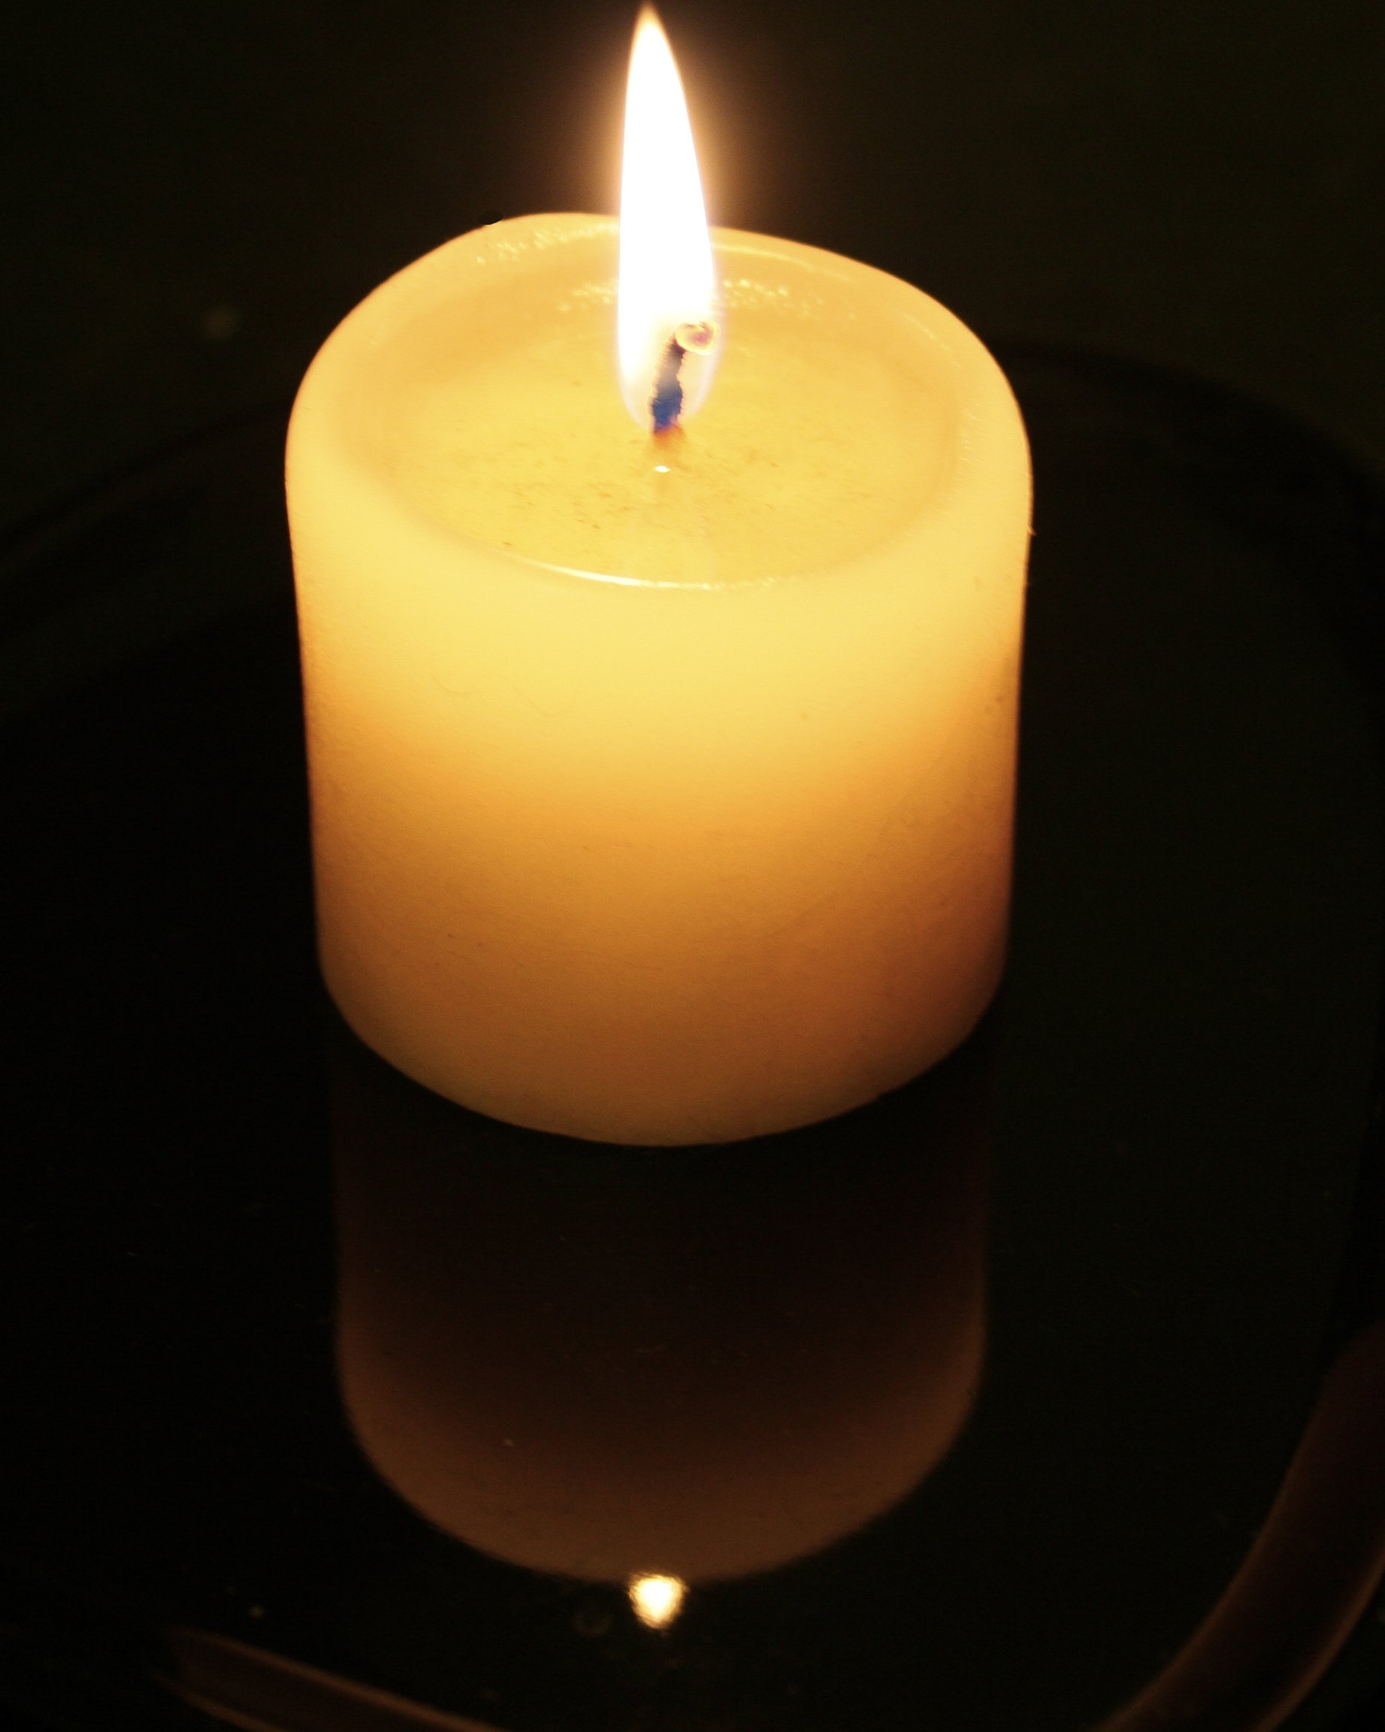
MEMORIAL MASS FOR
FATHER KEVIN DADSWELL
Saturday 13th July
8.00am Mass
ALL WELCOME

Slide 77

PARISH OFFICE CLOSED FRIDAY 5TH JULY

Slide 78

Are you new to our Parish?
Speak with one of our priests;
Email the Parish Office
Write name and contact details on forms at church doors.

Slide 79
Please take home your bulletins or download it from
www.stmichaelsparish.com

Slide 81
I have decided
I have decided to follow Jesus
I have decided to follow Jesus
I have decided to follow Jesus
No turning back, no turning back

Slide 82
The world behind me, the cross before me
The world behind me, the cross before me
The world behind me, the cross before me
No turning back, no turning back

Slide 83
Though none go with me, still I will follow
Though none go with me, still I will follow
Though none go with me, still I will follow
No turning back, no turning back

